Slide 1
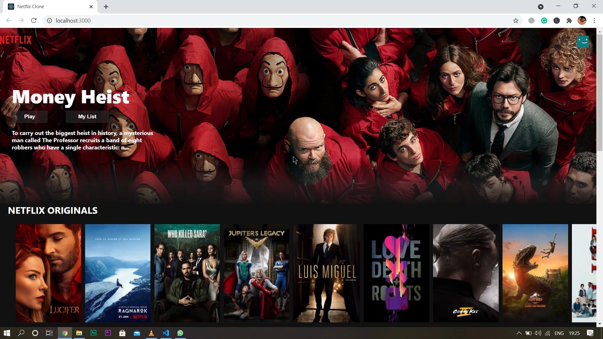
Build Netflix Clone Using React, HTML5 and CSS

